Slide 1

Global Terrorism
Exploratory Data Analysis

Slide 2

Point To Discuss
Data Summary
Data Cleaning
Top attacked in country, city, region, year, month, group
In world Map Top attacked country
Attacks in every year
Terrorist group name and number of killed
Max number of kill in each country which is greater then 200
AL-QAIDA
To check which region is affected by terrorism in each year
Most active gang in recent years
Top 11 most attacked country
Gang which killed most in recent year
Conclusion

Slide 3
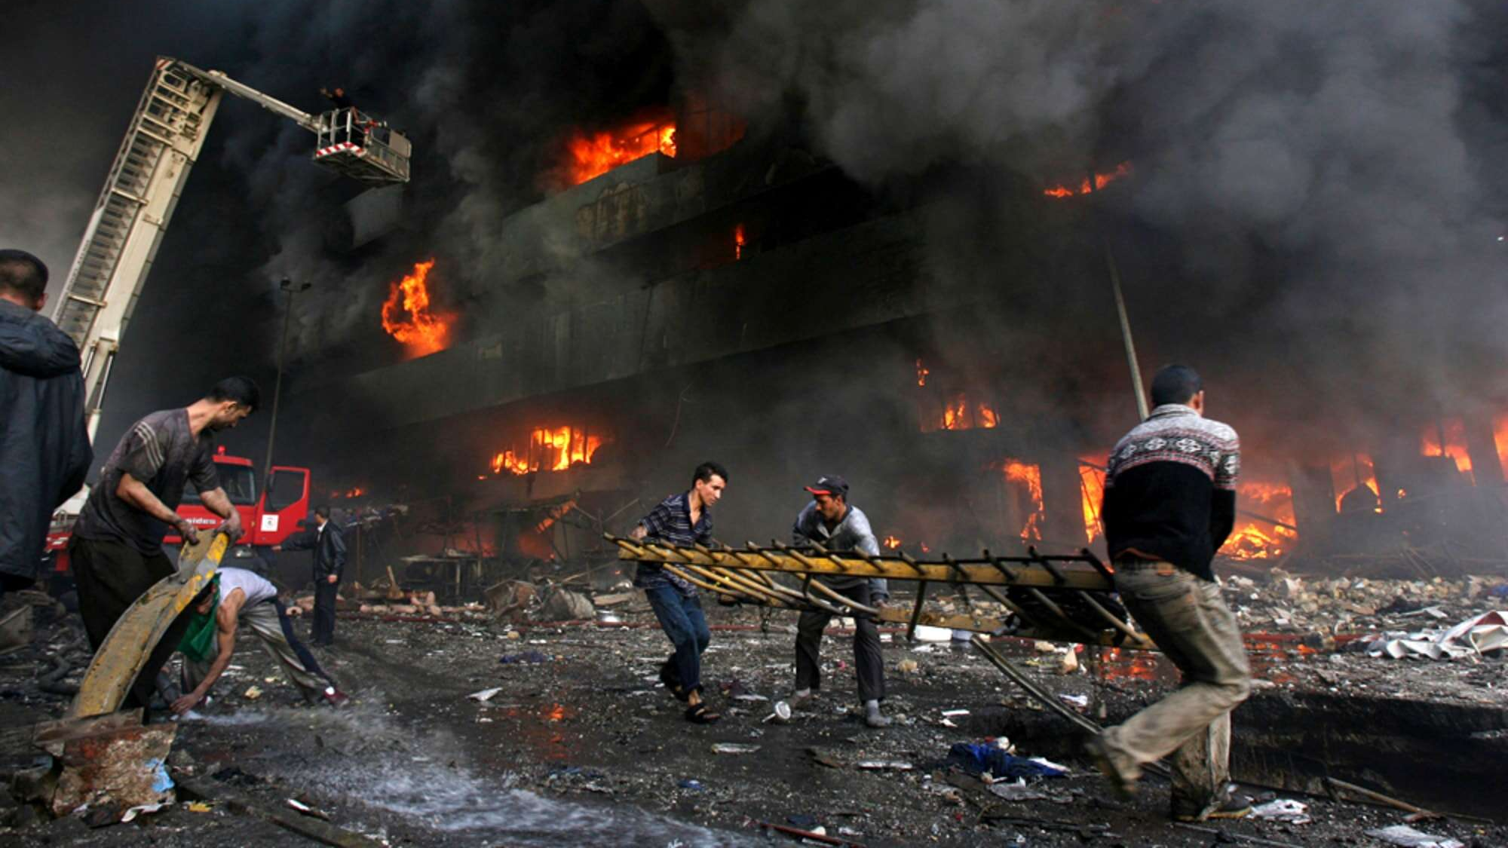
Data Summary/Data Cleaning
Shape of data
Rows-181691, columns- 135
Drop_column
name of coulmns which is having more then 10% of null values
Null_var
percentage of null values in each columns
Droped_df
droping the coulmns which is having more then 10% of null values
Dataset
Fully cleaned data

Slide 4
Top attacked in country, city, region, year, month, group
Country with most attacks: Iraq
City with most attacks: Baghdad
Region with the most attacks: Middle East & North Africa
Year with the most attacks: 2014
Month with the most attacks: 5
Group with the most attacks: Taliban
Most Attack Types: Bombing/Explosion

Slide 5
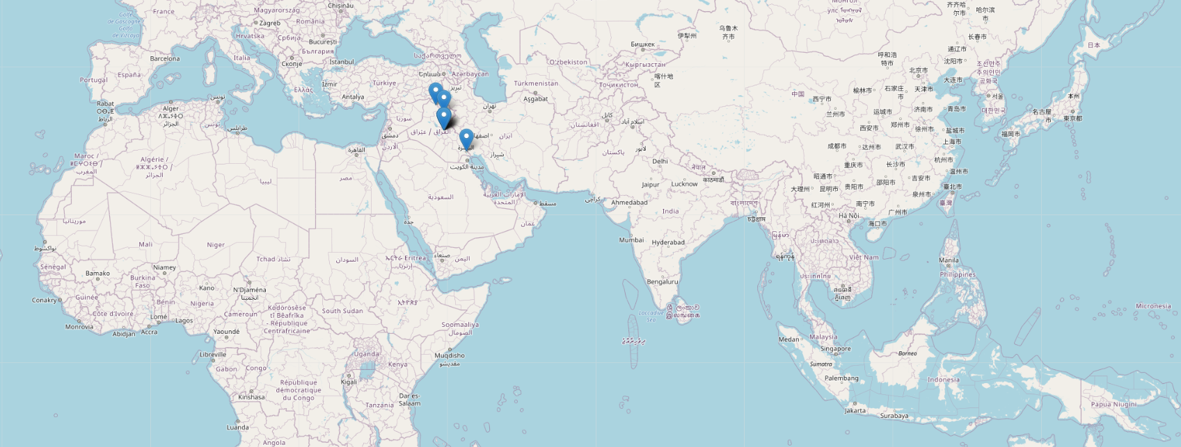
In world Map Top attacked country

Slide 6
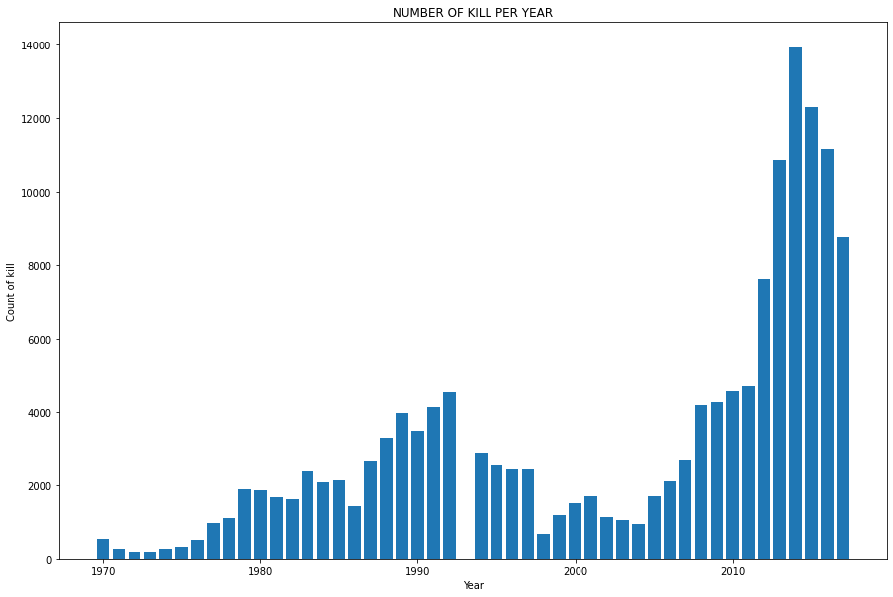
Attacks in every year
From above bar chart, we came to know about the total number of terrorist attacks with respect to different years.
We can conclude that most attacks were done in the year 2014.
We can see here that attacks slowly start to increase from 1972 until about 1993 where until 2004 we see a downward global trend in Terrorist incidents then after 2014 the terrorist activities starts increasing till 2014 then slowly decreases.

Slide 7
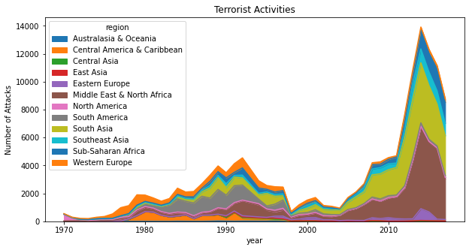
Terrorist Activities (Number of Attacks vs Year)
The above graph is plotted using area type of graph. It showing the total number of attacks in corresponding years and region. Most attacks were made in 2014 on Australasia & Oceania.
In the 1970s we can see that most terrorist attacks occurred in Western Europe, followed by Latin and South America in the 1980s.But then there is an overall decline in the number of attacks between the mid-1990s and 2003.

Slide 8
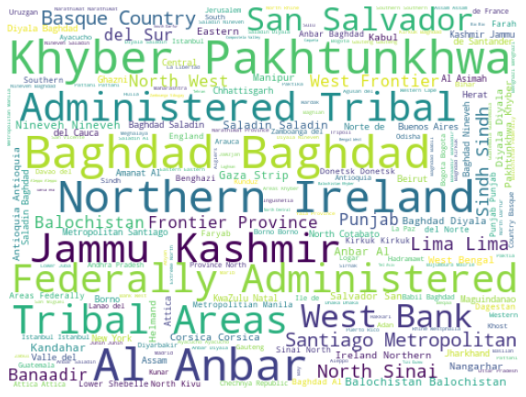
Word cloud
As we can see in this word cloud diagram that
Khyber Pakhtunkhwa
Administered Tribal
Baghdad
Northern Ireland
Jammu Kashmir

Slide 9
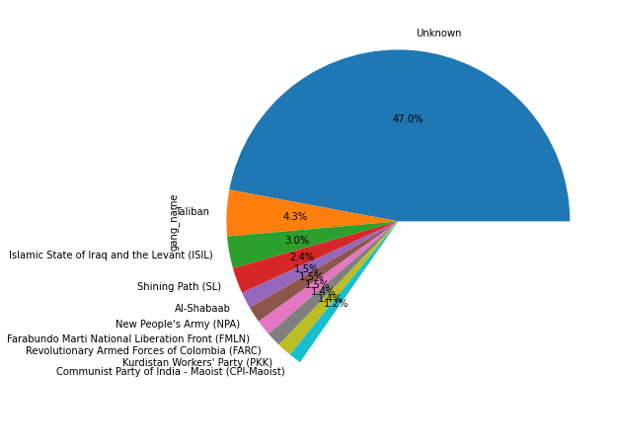
Percentage of attacks by each gangs out of total
The above figure is plotted using a pie chart. Which shows the percentage of attacks made by different terrorist groups out of total attacks.

Slide 10
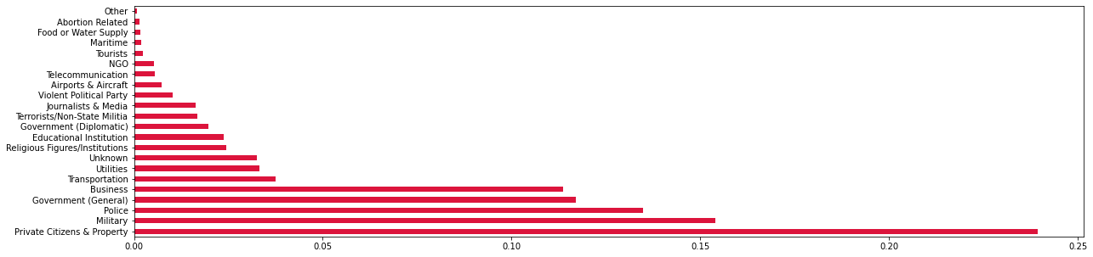
To know the target type of terrorists
From above graph, which depicts that most of the terrorist gangs targeted the private citizens and property followed by military, police

Slide 11
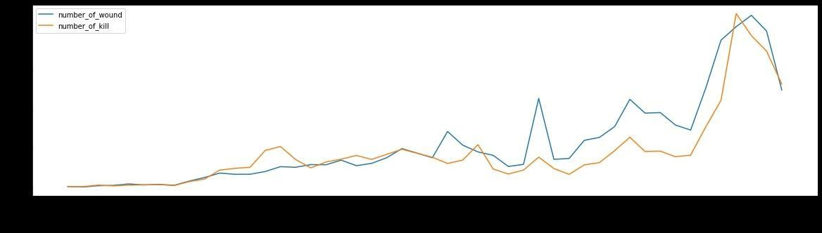
Compare the Number of kills and number of wounds
The above graph shows the number of kills and number of wounds by different terrorist groups. we can also compare the lines and day that number of people wounded more than the people killed.

Slide 12
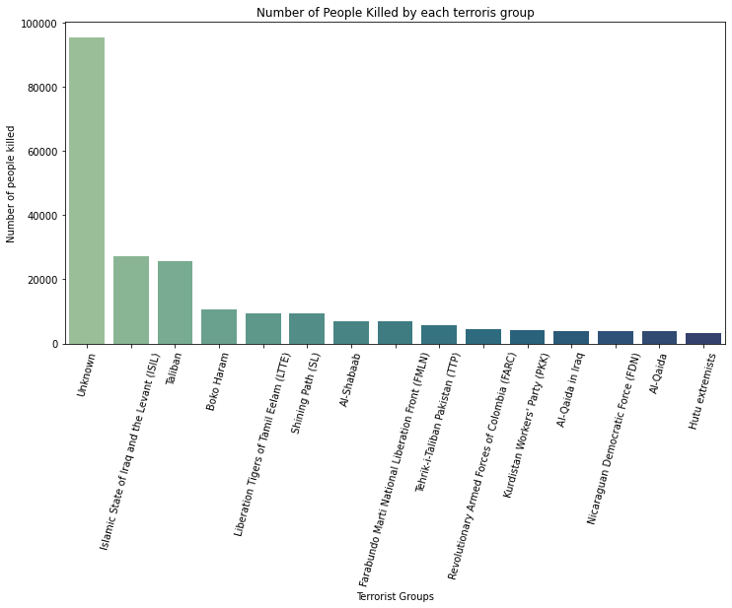
Terrorist group name and number of killed
From the bar graph ,which shows the number of people killed by different terrorist groups, we can say that most people were killed by terrorists which is unknown followed by ISIL and least number of people killed by Hutu extremists group.

Slide 13
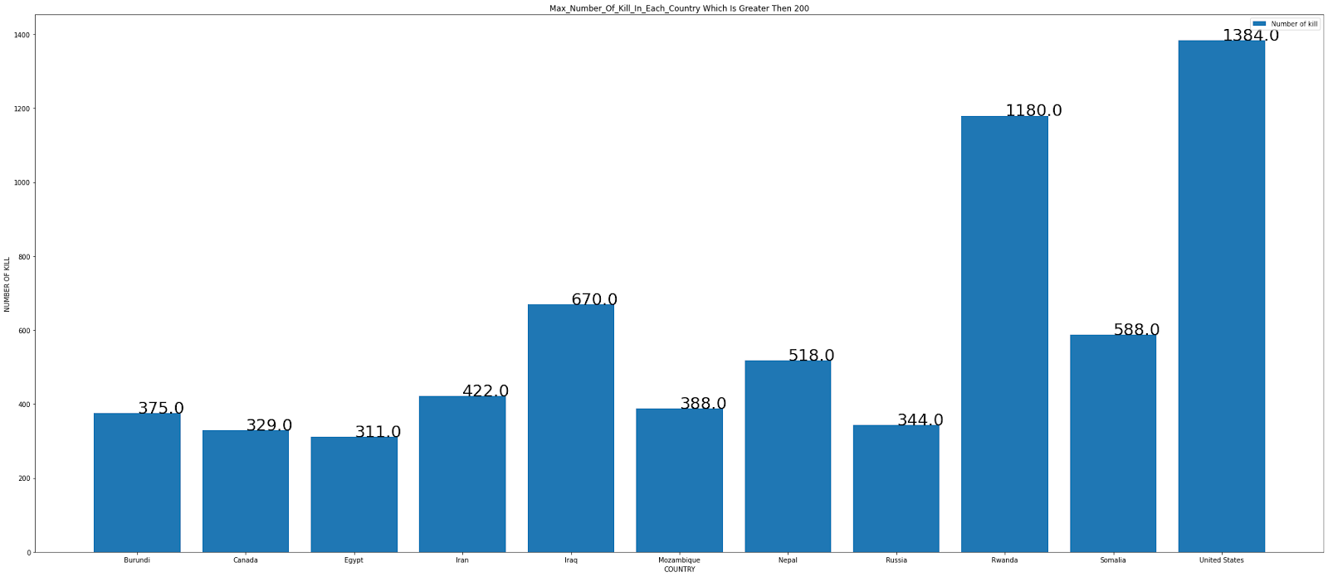
Max number of kill in each country which is greater then 200
The above bar graph, which displaying the total number of people killed in different countries. We can say that most people killed in United States i.e.,1384 people were killed.

Slide 14
AL-QAIDA
AL_qaida Most mischievous gang in early 20's and have done most number kill till date and the weapon used for killing is only two
Explosives and vehicle-borne explosive
so if we control on the illegal tranportation of weapons then we can reduse
we can see that in only one year (2001) there were 2 attacks on the same day so we can in same country
so we can say that there might me some disput between USA and Al_Qaida

Slide 15
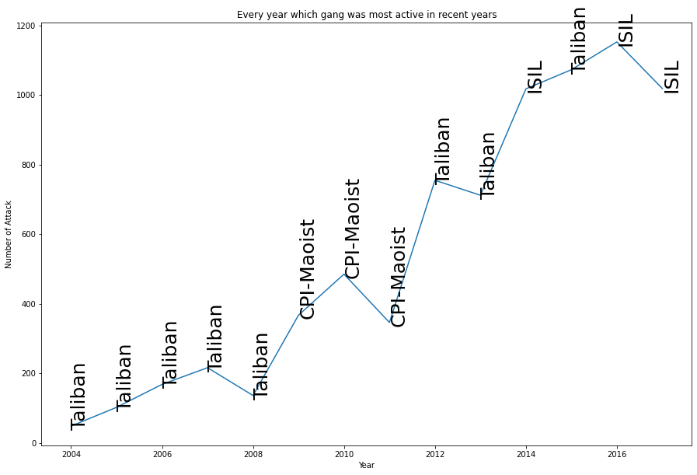
To check which region is affected by terrorism in each year
From the above graph, Which depicts the total number of attacks by different terrorist groups in respect to different years, we can say the most active terrorist gang.

Slide 16
Top 11 most attacked country
Country | Number of kill
Iraq | 21510
Pakistan | 12756
Afghanistan | 10871
India | 10491
Colombia | 6865
Philippines | 5843
Peru | 4916
Turkey | 3767
El Salvador | 3369
Thailand | 3346
United Kingdom | 3212

Slide 17
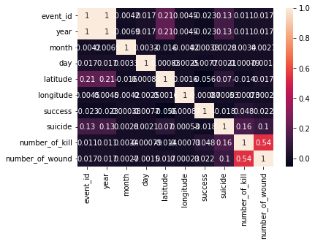
Correlations
Figure shows correlation matrix where darker the shade of the block, more the attributes are correlated proportionately. Here we can see that country and latitude are correlated which is expected. Values of neither of those two parameters change and hence they show a strong relation. This observation shows that most of the attacks are done by the citizen of their own country. Such a relation provides an interesting insight into how to perceive international terrorism as the proportion of international terrorism is significantly less in comparison with domestic terrorism. Attack type and weapon used in the attack also hold close ties with each other as attack type is defined based on the weapons used in that incident. Strangely ‘success’ which represents the rate of success of any attack, shows no significant connections with any other listed parameters. The block representing year and success has a darker shade which means that both these parameters are inversely related to each other. So, over time, the rate of success of any attack has reduced. This is a noteworthy observation that in an era of growing terrorism, counter-terrorist forces can restrict the success factor of attacks more than they used to.

Slide 18
Conclusion
1.Country with most attacks: Iraq
2.City with most attacks: Baghdad
3.Region with the most attacks: Middle East & North Africa
4.Year with the most attacks: 2014
5.Month with the most attacks: 5
6.Group with the most attacks: Taliban
7.Most Attack Types: Bombing/Explosion

Slide 19
Conclusion
gang_name VS number_of_kill
a) Islamic State of Iraq and the Levant (ISIL) 27174.0 b) Taliban 25785.0 c) Boko Haram 10732.0 d) Liberation Tigers of Tamil Eelam (LTTE) 9393.0 e) Shining Path (SL) 9315.0 f) Al-Shabaab 6836.0 g) Farabundo Marti National Liberation Front (FMLN) 6801.0 h) Tehrik-i-Taliban Pakistan (TTP) 5580.0 i) Revolutionary Armed Forces of Colombia (FARC) 4380.0 j) Kurdistan Workers' Party (PKK) 4093.0 k) Al-Qaida in Iraq 3984.0 l) Nicaraguan Democratic Force (FDN) 3883.0 m) Al-Qaida 3818.0 n) Hutu extremists 3203.0

Slide 20
Conclusion
1) Maximum human killed by Al-Qaida
2) In last 20 year Al-Qaida is not active Gang.
3) country VS number_of_kill
a)Iraq 21510 b) Pakistan 12756 c) Afghanistan 10871 d) India 10491 e) Colombia 6865 f) Philippines 5843 g) Peru 4916 h) Turkey 3767 i) El Salvador 3369 j) Thailand 3346 k) United Kingdom 3212

Slide 21
Conclusion
From Last 20 Year 3 Gang are active.
a) Taliban b) CPI c) ISIL

Slide 22
Conclusion
13.YEAR--GANG------NUMBER OF MAXIMUM KILL
a) 2004 ---Taliban--- 48
b) 2005 ---Taliban--- 102 c) 2006 ---Taliban--- 168 d) 2007 ---Taliban--- 216 e) 2008 ---Taliban--- 136 f) 2009 ---CPI-Maoist--- 367 g) 2010 ---CPI-Maoist--- 485 h) 2011 ---CPI-Maoist--- 346 i) 2012 ---Taliban--- 755 j) 2013 ---Taliban--- 712
k) 2014 ---ISIL--- 1018 l) 2015 ---Taliban--- 1073 m) 2016 ---ISIL--- 1153 n) 2017 ---ISIL--- 1019

Slide 23
Conclusion
14.These are two most method used by all three most active gang is Bombing/Explosion, Armed Assault and Hostage Taking (Kidnapping)
15.Al_Qaida Most mischievous gang in early 20's and have done most number kill till date and the weapon used for killing is only two Explosives and vehicle-borne explosive so if we control on the illegal transportation of weapons then we can reduce we can see that in only one year (2001) there were 2 attacks on the same day so we can in same country so we can say that there might me some dispute between USA and Al-Qaida

